Slide 1
Other Demand Elasticities and Elasticity of Supply

Slide 2
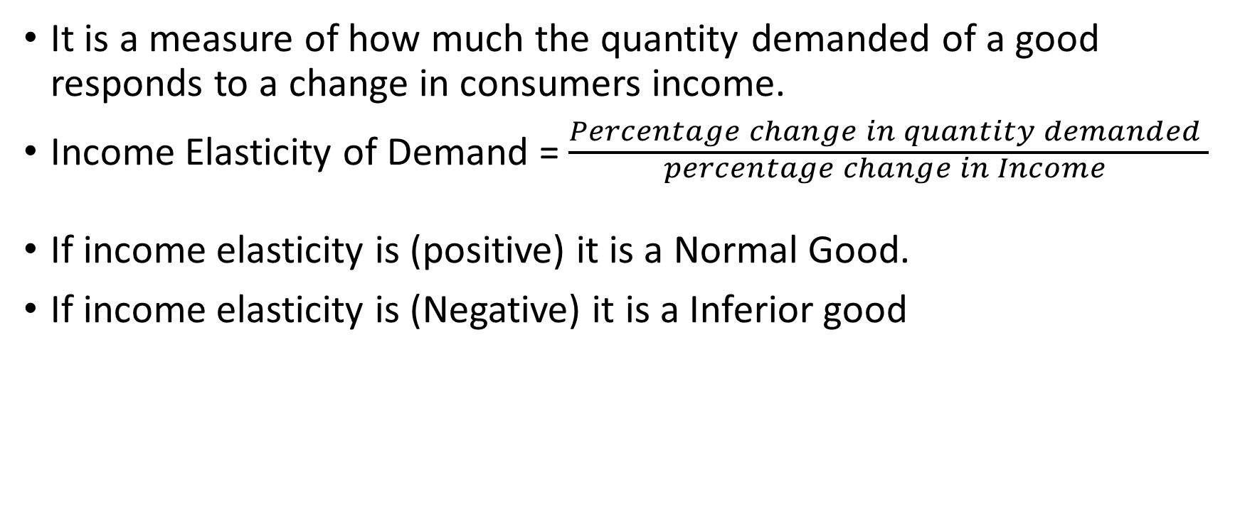
Income Elasticity of Demand
It is a measure of how much the quantity demanded of a good responds to a change in consumers income.
Income Elasticity of Demand = $\frac{Percentage change in quantity demanded }{\begin{aligned}percentage change in Income \\ \end{aligned}}$
If income elasticity is (positive) it is a Normal Good.
If income elasticity is (Negative) it is a Inferior good

Slide 3
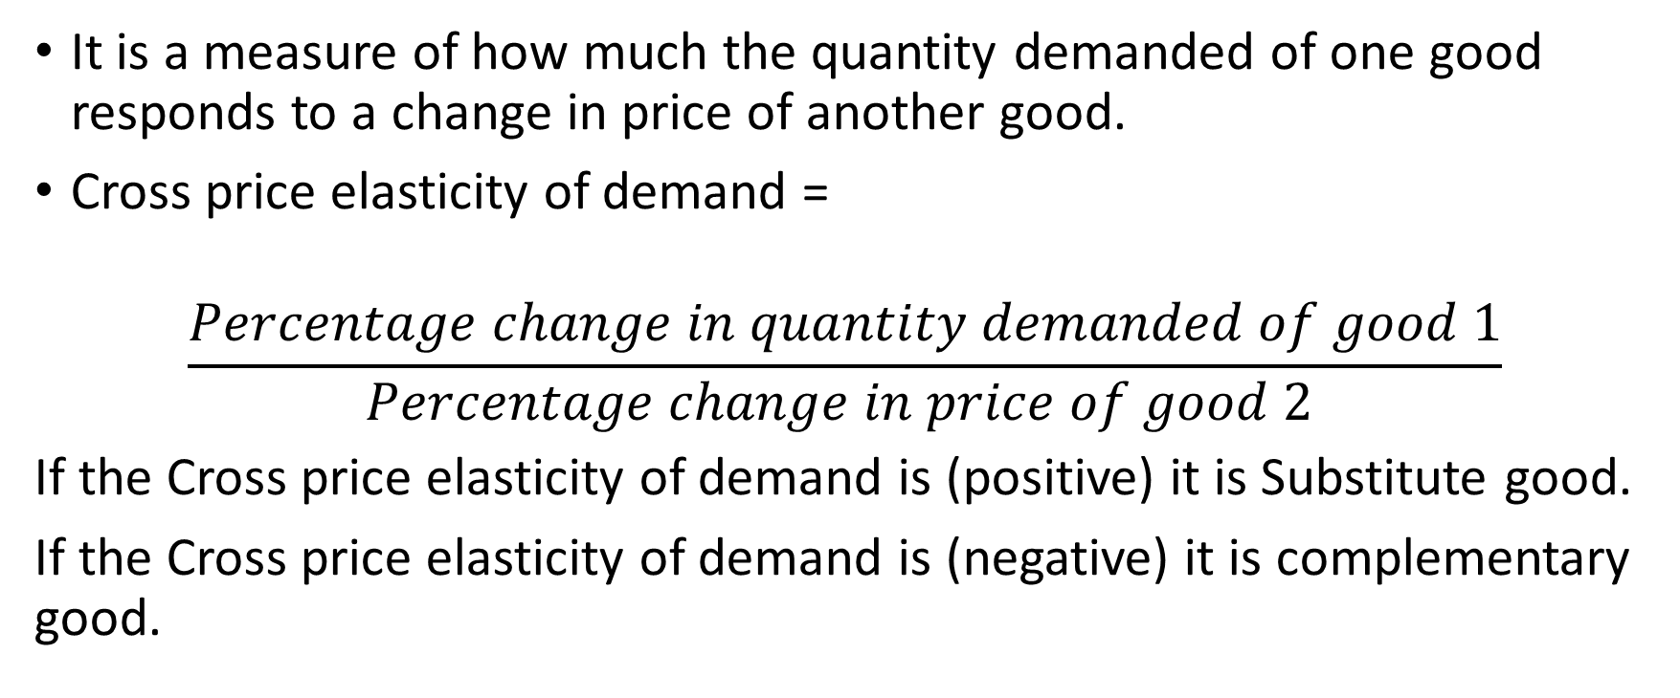
Cross Price Elasticity of demand
It is a measure of how much the quantity demanded of one good responds to a change in price of another good.
Cross price elasticity of demand =
$$\frac{Percentage change in quantity demanded of good 1}{Percentage change in price of good 2 }$$
If the Cross price elasticity of demand is (positive) it is Substitute good.
If the Cross price elasticity of demand is (negative) it is complementary good.

Slide 4
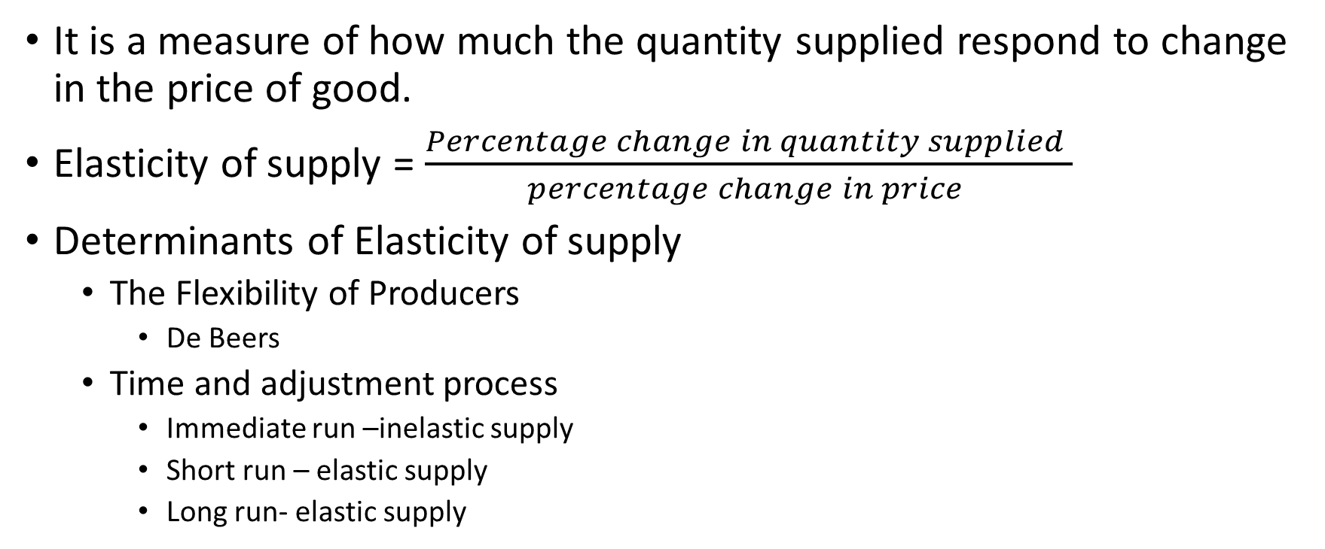
Elasticity of Supply
It is a measure of how much the quantity supplied respond to change in the price of good.
Elasticity of supply = $\frac{Percentage change in quantity supplied }{percentage change in price }$
Determinants of Elasticity of supply
The Flexibility of Producers
De Beers
Time and adjustment process
Immediate run –inelastic supply
Short run – elastic supply
Long run- elastic supply

Slide 5


Slide 6

Figure 6 The Price Elasticity of Supply
(a) Perfectly Inelastic Supply: Elasticity Equals 0
Price
Supply
€5
4
1. An
increase
in price . . .
0
100
Quantity
2. . . . leaves the quantity supplied unchanged.
Copyright©2003 Southwestern/Thomson Learning

Slide 7
Figure 6 The Price Elasticity of Supply
(b) Inelastic Supply: Elasticity Is Less Than 1
Price
Supply
€5
4
1. A 22%
increase
in price . . .
0
100
110
Quantity
2. . . . leads to a 10% increase in quantity supplied.
Copyright©2003 Southwestern/Thomson Learning

Slide 8
Figure 6 The Price Elasticity of Supply
(c) Unit Elastic Supply: Elasticity Equals 1
Price
Supply
€5
4
1. A 22%
increase
in price . . .
0
100
125
Quantity
2. . . . leads to a 22% increase in quantity supplied.
Copyright©2003 Southwestern/Thomson Learning

Slide 9
Figure 6 The Price Elasticity of Supply
(d) Elastic Supply: Elasticity Is Greater Than 1
Price
Supply
€5
4
1. A 22%
increase
in price . . .
0
100
200
Quantity
2. . . . leads to a 67% increase in quantity supplied.
Copyright©2003 Southwestern/Thomson Learning

Slide 10
Figure 6 The Price Elasticity of Supply
(e) Perfectly Elastic Supply: Elasticity Equals Infinity
Price
1. At any price
above €4, quantity
supplied is infinite.
€4
Supply
2. At exactly €4,
producers will
supply any quantity.
0
Quantity
3. At a price below €4,
quantity supplied is zero.
Copyright©2003 Southwestern/Thomson Learning

